Slide 1
Asset-Based
Long-Term Care Training
Webinar
Notes:
Welcome.
The purpose of this webinar is to get your familiar with several of the asset-based long-term care products offered by State Life. The information will not be all inclusive—so it is important that you review each product guide.

Slide 2
First some house keeping
A fixed annuity is a long-term, tax-deferred insurance contract designed for retirement. It allows an individual to create a fixed stream of income through a process called annuitization and also provides a fixed rate of return based on the terms of the contract. Fixed annuities have limitations. If your client decides to take money out early, they may face fees called surrender charges. Plus, if your client is not yet 59 ½, they may also have to pay an additional 10% tax penalty on top of ordinary income taxes. Your client should also know that a fixed annuity contains guarantees that are subject to the issuing insurance company’s ability to pay for them.
As your clients’ personal situations change (e.g., marriage, birth of a child, job promotion, retirement, relocation, etc.), so will their life insurance needs. Care should be taken to ensure this product is suitable for their long-term life insurance needs. They should weigh any associated costs before making a purchase. Life insurance has fees and charges associated with it that include costs of insurance that vary with such characteristics of the insured as gender, health and age, and has additional charges for riders that customize a policy to fit their individual needs.
Riders are optional and carry an additional cost. The long-term advantage of an optional benefit will vary with the terms of the benefit option and the length of time the product is owned. As a result, in some circumstances, the cost of an option may exceed the actual benefit paid under the option.
Please note that the replacement of an existing annuity must not be made unless all factors are weighed and it is documented as suitable for the client.
Products underwritten and issued by The State Life Insurance Company, Indianapolis, Indiana. Policy Forms: Asset-Care: L301, SA31 and R501 (or state variation); Annuity Care and Annuity Care II: SA34, SA35, R508. Product and riders may not be available in all states or may vary by state.
All guaranteed are subject to the claims paying ability of State Life.
For company and recruiting use only. Not for public distribution.
Notes:
We will pause for a moment and let you read that following disclosures.

Slide 3
The State Life Insurance Company—
A OneAmerica® Company
A history of strong company financials
Record sales, assets, earnings, capital, and sales force growth in 2010
An investment portfolio that is among the strongest in the industry
Upgraded to A.M. Best rating A+ ( 2nd highest of 16 possible ratings) May 2011
For company and recruiting use only. Not for public distribution.
Notes:
At State Life and OneAmerica, we believe in providing a robust product portfolio. But just as important, we back up our products with strong company financials. In fact, we were recently upgrade by A.M. Best to A+!

Slide 4
LTC Market
Declining sales
Inforce rate increases
Companies exiting the market
For company and recruiting use only. Not for public distribution.
Notes:
Before we get too in depth on the Care Solutions portfolio of asset-based long-term care products, let’s first discuss the long-term care market as a whole.

Slide 5
LTCI New Business Trends
2005 - 2009
For company and recruiting use only. Not for public distribution.
Notes:
According to LIMRA, long-term care insurance sales have had a challenging five years.

Slide 6
Result? More relying on Assets
For company and recruiting use only. Not for public distribution.
Notes:
As a result, more and more individuals are relying on their own assets to pay for any future long-term care costs. Here is what a portfolio might look like—painted with a broad brush.

Slide 7
Leveraged Assets
For company and recruiting use only. Not for public distribution.
Notes:
When we say individuals are relying on assets to pay for long-term care, it can mean two different things. First, they may decide to go-it-alone and pay for any expenses out of pocket. More recently, though, solutions that leverage existing assets for long-term care have gained popularity.

Slide 8
Care Solutions Portfolio
Asset Care® – Whole life insurance with LTC benefits
Asset Care I -- Cash or cash equivalents (single premium)
Asset Care II – Existing nonqualified annuities via 1035 exchange (single premium)
Asset Care III – Qualified money via direct rollover (single premium)
Asset Care IV – 10-20 limited pay or lifetime pay (annual premium)
Annuity Care ® – Single premium deferred annuity with LTC benefits
Annuity Care – Cash, qualified money, existing nonqualified annuities via 1035 exchange
Annuity Care II – Cash or existing nonqualified annuities via 1035 exchange
Annuity Care III—Qualified money conversion strategy
Legacy Care ® – Single premium deferred annuity designed for the needs of the retiree market
Immediate Care ® – Immediate annuity (SPIA) designed to help fund LTC
Notes:
Let’s looks at a brief overview of the Care Solutions portfolio and how each solution is funded.

Slide 9
For company and recruiting use only. Not for public distribution.
Life Insurance with
LTC benefits: Asset-Care®
Husband and wife, each 65
Plus:
4% minimum guaranteed interest rate
Optional lifetime coverage available with guaranteed premiums
Patented joint life option
Immediately
$100,000 single premium
$207,516 death and LTC benefit
Need it for LTC?
You receive: $4,150 monthly LTC benefit
If you surrender
You receive
at least your $100,000
If you die?
You receive
$207,516
Available lifetime benefits
Numeric examples are hypothetical and were used for educational purposes only.
Notes:
Asset-Care is whole life insurance that leverages a single premium into a death benefit that can be used for qualifying long-term care expenses. Unlike traditional long-term care insurance, Asset-Care provides a benefit if care is never needed.

Slide 10
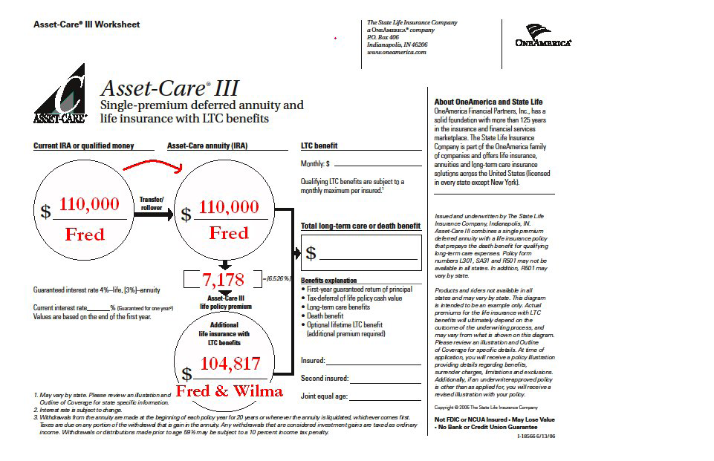
Qualified Money
For company and recruiting use only. Not for public distribution.
Note: please review form number I-8566 in its entirety for complete details
Numeric examples are hypothetical and were used for educational purposes only.
Notes:
With its four versions, almost any asset can be used as a premium for Asset-Care. One of the most popular versions, Asset-Care III, utilizes qualified money as its premium.

Slide 11
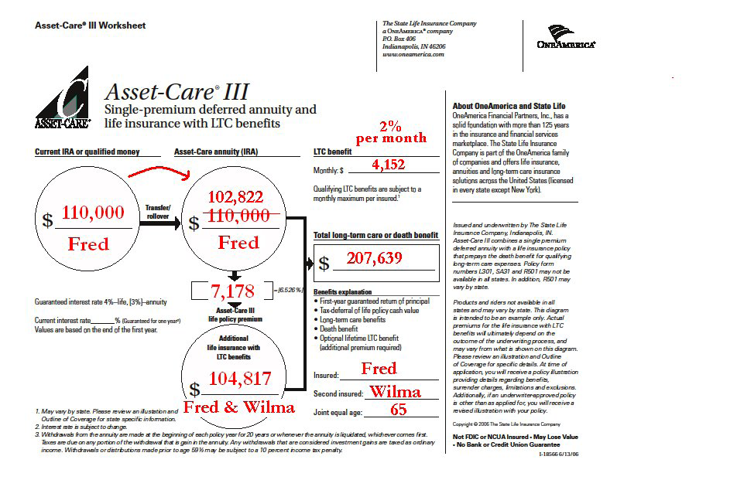
Qualified Money
For company and recruiting use only. Not for public distribution.
Note: please review form number I-8566 in its entirety for complete details
Numeric examples are hypothetical and were used for educational purposes only.
Notes:
You can see in this example how a lump sum of qualified money can be used to provide LTC protection to both spouses.
The single premium is directly rolled into a single premium deferred annuity. From that lump sum a withdrawal is taken annually to fund a 20-pay whole life policy with LTC benefits. In this example, $110,000 is rolled into the annuity. The first annual distribution of $7,178 is taken and provides an initial death benefit of $104,817. This amount, combined with the remaining $102,822 in the annuity, provides a total LTC benefit of $207,639. 2% of this amount may be accessed for qualifying LTC benefits.

Slide 12
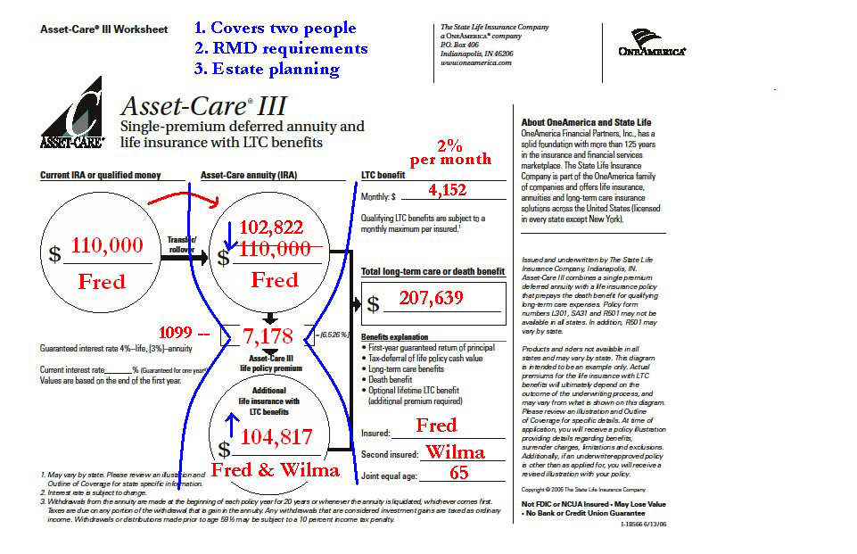
Qualified Money
For company and recruiting use only. Not for public distribution.
Note: please review form number I-8566 in its entirety for complete details
Numeric examples are hypothetical and were used for educational purposes only.
Notes:
Asset-Care III can provide a useful outlet for unneeded Required Minimum Distributions and offer estate advantages by slowly turning taxable qualified money into non-income taxable LTC and death benefits.

Slide 13
Annuity Statistics
1.57 Trillion = total deferred annuity assets
LIMRA, The 2008 Individual Annuity Market
141 billion = 2008 non-qualified deferred annuity sales
LIMRA, The 2008 Individual Annuity Market
Non-qualified annuity average purchase age – 66
The Gallup Organization, 2009 Survey of Non-Qualified Annuity Contracts
How Many will Die with Annuity?
For company and recruiting use only. Not for public distribution.
Notes:
The potential to use annuities to fund LTC expenses is also significant, because the annuity market is so large. There are huge numbers of assets in annuities and the average age of annuity owners is around where preparring for LTC becomes more important.

Slide 14
Annuities
According to 2009 Gallop survey of
Non-Qualified Annuity owners:
  83 % intend to use their annuity as a financial resource to avoid being a financial burden on their children
  73% intend to use their annuity as an emergency fund in the case of a catastrophic illness or for nursing home care
For company and recruiting use only. Not for public distribution.
Notes:
Some research even indicates that annuity owners purchased their annuity with unexpected medical and health care costs in mind.

Slide 15
Changing Market Place
Interest rate market vs. value market
Low interest rates
Low guarantees
Value – PPA and Annuity Care® can give new life to annuities.
For company and recruiting use only. Not for public distribution.
Notes:
With the current sustained low interest rate environment, annuity selling points like guaranteed rate are less important. What is important is value. Value like the Pension Protection Act tax advantages.

Slide 16
Leveraged Asset
For company and recruiting use only. Not for public distribution.
Notes:
Just like Asset-Care, Annuity solutions offer the opportunity to leverage existing assets for long-term care benefits. We offer two such solutions,
Annuity Care and Annuity Care II.

Slide 17
KEY SIMILARITES: PENSION PROTECTION ACT
Existing annuity
(funded with
after-tax
dollars)
$50,000 basis
+
$100,000 gain
=
$150,000 cash value
Taxes owed on gain
which is withdrawn first
Withdrawal
1035 Exchange
Long-term care expenses
$150,000
Withdrawal
HIPAA qualified PPA
eligible annuity
Income tax-free as a reduction of cost basis
For company and recruiting use only. Not for public distribution.
Not FDIC Insured-May Lose Value-Not Bank Guaranteed –For company and recruiting use only - Not for Public Distribution
Notes:
Both products are eligible for the tax advantages of the Pension Protection Act. As you know the PPA only applies to policies funded with nonqualified after-tax dollars. Now let’s look at how each product works.

Slide 18
CONTINUATION OF BENEFITS
ANNUITY CARE
Separate Contracts
ANNUITY 36 Months
C.O.B 36 months
C.O.B. is Optional
Note: benefit periods listed are shared if two annuitants
For company and recruiting use only. Not for public distribution.
Not FDIC Insured-May Lose Value-Not Bank Guaranteed –For company and recruiting use only - Not for Public Distribution
Notes:
With original Annuity Care, the base annuity and continuation of benefits are purchased separately. The continuation of benefits is optional.

Slide 19
CONTINUATION OF BENEFITS
ANNUITY CARE
C.O.B 36 months
ANNUITY 36 Months
Life Time Benefits
C.O.B. is Optional
For company and recruiting use only. Not for public distribution.
Notes:
What is unique about Annuity Care though, is that the continuation of benefits offers a lifetime benefit option and premiums that are guaranteed never to increase.

Slide 20
CONTINUATION OF BENEFITS
Max Age 85
ANNUITY CARE
C.O.B 36 months
$150,000 = Total $300,000
ANNUITY 36 Months
$150,000 / 2.9% per MO
Life Time Benefits = Unlimited
C.O.B. is Optional
Initial Monthly Benefit $4,350
Numeric examples are hypothetical and were used for educational purposes only.
For company and recruiting use only. Not for public distribution.
Notes:
Annuity Care’s maximum issue age is 85 and here is an example of what a single premium of $150,000 can do. This example is based upon current interest rates.
As you can see, the continuation of benefits two options. The first is to double the annuity benefit period. The second is lifetime coverage.

Slide 21
CONTINUATION OF BENEFITS
ANNUITY CARE II
ANNUITY
C.O.B.
C.O.B. is Included
For company and recruiting use only. Not for public distribution.
Not FDIC Insured-May Lose Value-Not Bank Guaranteed –For company and recruiting use only - Not for Public Distribution
Notes:
With Annuity Care II, The continuation of benefits is built-in. Annuity Care II cannot be purchased without the continuation of benefits.

Slide 22
PAYMENT OF C.O.B. PREMIUM
ANNUITY CARE II
ANNUITY
C.O.B.
Monthly charge for COB
C.O.B. is Included
For company and recruiting use only. Not for public distribution.
Not FDIC Insured-May Lose Value-Not Bank Guaranteed –For company and recruiting use only - Not for Public Distribution
Notes:
Rather than paying for the continuation of benefits out-of-pocket as with Annuity Care, Annuity Care II’s continuation of benefits is funded by a monthly charge deducted from the annuity values.

Slide 23
PAYMENT OF C.O.B. PREMIUM
ANNUITY CARE II
ANNUITY
C.O.B.
Monthly charge for COB
36 Mo
C.O.B. is Included
For company and recruiting use only. Not for public distribution.
Not FDIC Insured-May Lose Value-Not Bank Guaranteed –For company and recruiting use only - Not for Public Distribution
Notes:
Annuity Care II offers three COB options. The first is an additional 36 months, or three years.

Slide 24
CONTINUATION OF BENEFITS
ANNUITY CARE II
ANNUITY
C.O.B.
Monthly charge for COB
36 Mo
C.O.B. is Included
72 Mo
For company and recruiting use only. Not for public distribution.
Notes:
The second is an additional 72 months, or 6 years

Slide 25
C.O.B. OPTIONS
ANNUITY CARE II
ANNUITY
24 Mo Single
30 Mo Joint
C.O.B.
Age 80
Monthly charge for COB
36 Mo
C.O.B. is Included
Age 75
72 Mo
Age 70
108 Mo
For company and recruiting use only. Not for public distribution.
Notes:
The third is an additional 108 months, or 9 years.
Annuity Care II’s base policy provides the first 24 or 30 months of LTC benefit depending on whether the policy is joint or single. From there the three continuation of benefits options are available based upon the applicant’s age.
The 36 month continuation of benefits is available to age 80, or all issue ages.
The 72 month continuation of benefits is available to age 75.
The 108 month continuation of benefits is available to age 70.

Slide 26
C.O.B. OPTIONS
For company and recruiting use only. Not for public distribution.
ANNUITY CARE II
Female Age 70
Monthly charge for COB
ANNUITY
$100,000
C.O.B.
$150,000
$250,000 LTC
C.O.B. is Included
36 Mo
72 Mo
Note: The amount of COB benefit is based on sex, age at issue and the LTC claims method chosen
108 Mo
Numeric examples are hypothetical and were used for educational purposes only.
Notes:
Here is a real basic example of how Annuity Care II can work. In this example, $100,000 is the single premium and purchases an additional $150,000 of COB benefit for a total benefit of $250,000.
Again, these are just round numbers for example purposes.

Slide 27
C.O.B. OPTIONS
For company and recruiting use only. Not for public distribution.
ANNUITY CARE II
Female Age 70
Monthly charge for COB
ANNUITY
$100,000
C.O.B.
$150,000
$250,000 LTC
C.O.B. is Included
36 Mo
$400,000 LTC
$300,000
72 Mo
Note: The amount of COB benefit is based on sex, age at issue and the LTC claims method chosen
108 Mo
Numeric examples are hypothetical and were used for educational purposes only.
For company nd recruiting use only. Not for public distribution.
Notes:
The 72 months continuation of benefit would provide an even larger pool of potential long-term care benefits.

Slide 28
C.O.B. OPTIONS
For company and recruiting use only. Not for public distribution.
ANNUITY CARE II
Female Age 70
Monthly charge for COB
ANNUITY
$100,000
C.O.B.
$150,000
$250,000 LTC
36 Mo
C.O.B. is Included
$400,000 LTC
$300,000
72 Mo
$550,000 LTC
$450,000
Note: The amount of COB benefit is based on sex, age at issue and the LTC claims method chosen
108 Mo
Numeric examples are hypothetical and were used for educational purposes only.
Notes:
While the 108 month continuation of benefit can provide the largest potential benefit. Again, continuation of benefit option availability is based upon the age of the applicant.

Slide 29
OTHER KEY DIFFERENCES
ANNUITY CARE
ANNUITY CARE II
Partial 1035’s
Yes
No
Benefit Type
Reimbursement
Reimbursement or Indemnity
Elimination Period
7 Days
90 Days
Qualified Funds
Yes*
No
*If funded with qualified funds, withdrawals for qualifying long-term care expenses are NOT eligible to be PPA compliant.
Not FDIC Insured-May Lose Value-Not Bank Guaranteed –For company and recruiting use only - Not for Public Distribution
Notes:
There are also other key differences between the products. Annuity Care can accept partial 1035 exchanges, however, because of partial 1035 exchange rules, Annuity Care II cannot.
Annuity Care claims are paid on a reimbursement basis, while Annuity Care II applicants may select either the reimbursement or Indemnity claim payment method at the time of application.
Annuity Care has a 7-day elimination period while Annuity Care II’s elimination period is 90-days
Finally, Annuity Care can accept both qualified and non-qualified funding sources while Annuity Care II only accepts non-qualified sources.

Slide 30
The State Life Sales Desk
1-800-275-5101
For company and recruiting use only. Not for public distribution.
Notes:
At this point I would be happy to answer any questions. Also remember that you can contact the State Life Sales Desk for more information and training on the Care Solutions products.

