Slide 1
Power Plus Marketing
Efficient ways to find buyers

Slide 2
Power Plus Marketing
It starts with a Power mindset

Slide 3
Which approach is the right approach?
Lets consider our options...
Knowing we likely can’t effectively sell our offering over the phone.
We are looking to set an appointment.

Slide 4
We basically have 3 approaches:
Prospect with a product
Prospect with services
Prospect with ideas

Slide 5
Product Approach
In our industry, people don’t buy products…
They buy what products do.
And they often have a pre-conceived notion about it.
The product approach works best when you’ve run into a potential buyer who is already looking.

Slide 6
Product Approach Weaknesses
They already know what they want and
They’re shopping price and
They are in control
You’re forced into a commodity sale.
Probably losing revenue in the process
2. And what happens when another, better product comes along?
We are not saying this approach won’t work, but consider what the commoditization of car insurance has done to their profit margins…

Slide 7
Services Approach
We engage by offering a service:
Financial Planning, Estate Planning, Investment Planning, etc.
People who respond are usually already looking for the “service” or think they already have it, and are therefore not interested…

Slide 8
Services Approach Challenges:
It can be very difficult to distinguish yourself from others providing the same service on the approach:
For example:
What are you going to say when they tell you they already have a financial planner?
“My financial planning is better than their financial planning!”

Slide 9
Prospecting with Ideas
Prospecting with ideas, done correctly, allows us to bypass the sales filter of the prospect and fuel their curiosity to learn more.
The million dollar question is all about creating curiosity with something almost every prospect of means will want to know more about.
And allow you to move to set the appointment as the only way the prospect can satisfy their curiosity.

Slide 10
The Million Dollar Question
Do you have it memorized?
“If we could show you a way to move money from your business to yourself, in a very tax efficient manner, and your CPA thought it to be a good idea, is there any reason you wouldn’t want to know about it?”

Slide 11
Inventory

Slide 12
What’s your inventory?
Building a pipeline:
We all need prospect inventory to have someone to buy our products, services, etc.
What’s your plan and/or procedure to fill your pipeline?
The hard way vs. the easy way

Slide 13
Please make it easy!
Lets run down the best strategies for finding new business and new prospects:
1. Marketing thru CPA’s
Smart CPA’s have come to the realization they need to be more than just a human version of Quicken to keep their business clients.

Slide 14
CPA Marketing
Smart CPA’s are looking for ideas that provide meaningful tax relief, and also know
Additional revenue can be realized by way of providing new found relief.
Some may want to commission share
Some may want only to create new fee income.
Either way, you win as 80% of the time, the client will act upon their CPA’s advise.

Slide 15
CPA Marketing
How do I get in front of CPA’s on a favorable basis?
Do you currently know any? Make a list…
Ask your clients to introduce you
Ask your friends to introduce you… wait a minute, I don’t have any friends…
Invite CPA’s to attend a free industry approved CE seminar

Slide 16
CPA Marketing Network Alliance
Some CPA’s won’t listen to agents…
They will usually listen to other CPA’s
Would you spend $200.00 to have a highly qualified, 79 friendly CPA talk to your potentially revenue killing CPA?

Slide 17
Please make it easy!
2. Marketing thru existing clients and friends:
Learn the “third Party” version of the Million Dollar Question:
“Hey Bob, we all know birds of a feather flock together right?: Who do you know, like you, who would want to know about a powerful way to move money from their business to themselves, in a very tax efficient manner, that smart CPA’s by the way really like; who do you know that should learn about this Bob?, who do you know that hates paying taxes?”
Hey… What about me?
9 times out of 10, they will immediately ask you to show it to them!

Slide 18
Don’t Forget
The children of your older estate planning clients as they’re probably running the business

Slide 19
Champion Agency Website Tools
Go to: Building Your Financial Services Practice
www.champion-agency.com
Really useful tools such as the one-card system
Don’t throw anyone away… use the one-card system.
The only way out of the box is to die or buy!

Slide 20
Unique Direct Mail
When was the last time you actually received a traditional letter?
What gets you to open a letter?
It looks personal, private, not like junk mail.
People are opening mail again! Try it.

Slide 21
Just Do IT
Walk and talk…
Meet business owners by walking into their business.
Attending Chamber of Commerce events
Get involved with non-profits
Parties where business owners will likely be
Ask your current business owner clients to introduce you to the business next door

Slide 22
The Net Differential
Do I really understand it?
Lets back-test:

Slide 23
So how does it all work?
First off, what ever my company pays me is tax deductible to the business.
But…

Slide 24
We all know that Uncle Sam shares in our earning through income tax.
If I’m in a 40% tax bracket, Uncle Sam normally gets 40% and I get 60%.
40%
40%
60%
60%
So…

Slide 25
Before we can run with the money…
We need to pay our applicable taxes:
Now, Lets assume you want to invest a net of $100,000

Slide 26
Here’s the bottom line:
Power Plus designs reduce the amount needed from the business:
Without Power Plus, here’s what happens:
$67K

Slide 27
Here’s the bottom line:
Without:
Business Must Pay:
$166,667
$67K
$100K
For You To Get:
$100,000

Slide 28
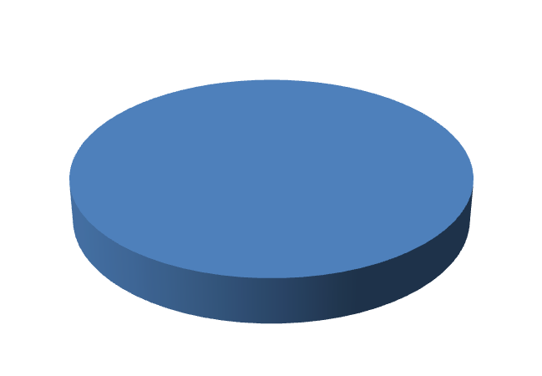
Here’s the bottom line:
Power Plus designs reduce the amount needed from the business:
With:
Business Only Pays:
$100,000
$100K
And the business saves:
$66,667!
For You To Get:
$100,000

Slide 29
Here’s the bottom line:
Power Plus designs reduce the amount needed from the business:
With:
Business Only Pays:
$100,000
$100K
And the business saves:
$66,667!
For You To Get:
$100,000
(Net Differential)
“I’m Happy Too!”

Slide 31
The Game is always won in the fourth quarter
Power Product sales create large case commissions!
Start filling your pipeline now, and as we approach the fourth quarter of the year, tax reduction emotions ignite action by prospects.
Start filling the pipeline today!

