Slide 1
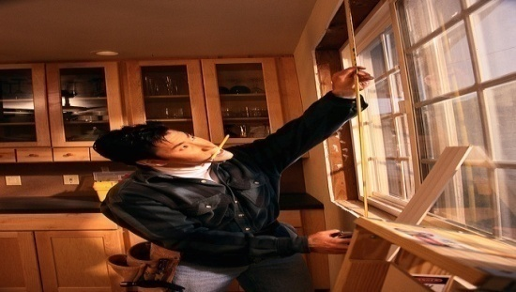
Defining Disability
Presented by: Reed H. Schnittker, RHU
The Plus Group U.S.

Slide 2
What ????
Regular Occ
Own Occ
Transitional Your Occupation
Your Occupation
Specialty Own Occupation
TYO
Modified Own Occupation
Any Occupation
2

Slide 3
Any Occupation
Total Disability is defined as your inability to work in Any Occupation that your are reasonably suited to, by your education, training and experience.
3

Slide 4
Modified Own Occ
You are totally disabled if, because of your injury or sickness: your are unable to perform the substantial and material duties of your regular occupation; and you are not engaged in any other gainful occupation.
4

Slide 5
Example of Modified Own Occ
You are an Architect and you are unable to do the material and substantial duties of your occupation. You choose not to pursue any other gainful employment. You are entitled to full disability benefits.
5

Slide 6
Transitional Your Occ (TYO)
Allows the insured to receive a total disability benefit if he or she is disabled in his or her regular occupation, but is working in another occupation and disability income benefits when combined with earned income from new occupation does not exceed the prior earnings.
6

Slide 7
Example of Trans Your Occ
Physician earning $500,000, has $15,000 of monthly benefit, he becomes disabled from his regular occupation and chooses to teach at the medical school where he will be paid $150,000.
Prior Earnings $500,000
New Occupation Earnings $150,000
Annual Disability Benefit $180,000
Total Payout while disabled is $330,000
The earnings threshold in this example is $320,000 in a new occupation

Slide 8
True Own Occupation
Your Occ
Own Occ
Specialty Occ
Regular Occ
8

Slide 9
Definition of True Own Occ
Allows the insured to receive a total disability benefit if he or she is disabled in his/her regular occupation, but can work in another occupation.
9

Slide 10
Example of True Own Occ
Suppose the insured, who is a trial attorney, loses his ability to speak due to an illness. He can no longer do the material and substantial duties of his occupation since he cannot present a case in court. However, the insured is able to be gainfully employed at the firm doing legal research work for other attorneys.
10

Slide 11
Questions????? Please contact your local Plus Group office for more information. Go to www.plusgroupus.com and click on the office locator map to find an office near you or call 800/831-1018
11

