Slide 3
Notes:
Price Elasticity with Forbes- Why did you not buy- #1 Reason Price not a ROR

Slide 4
Notes:
Research 3:1 Rate of Return was no concern

Slide 5
Notes:
46% are choosing Benefit Builder- Voluntary and Automatic Components. Fantastic Price Point (50% of 3% Compound Rates or 25% of 5% Compound of competitor policies.

Slide 6
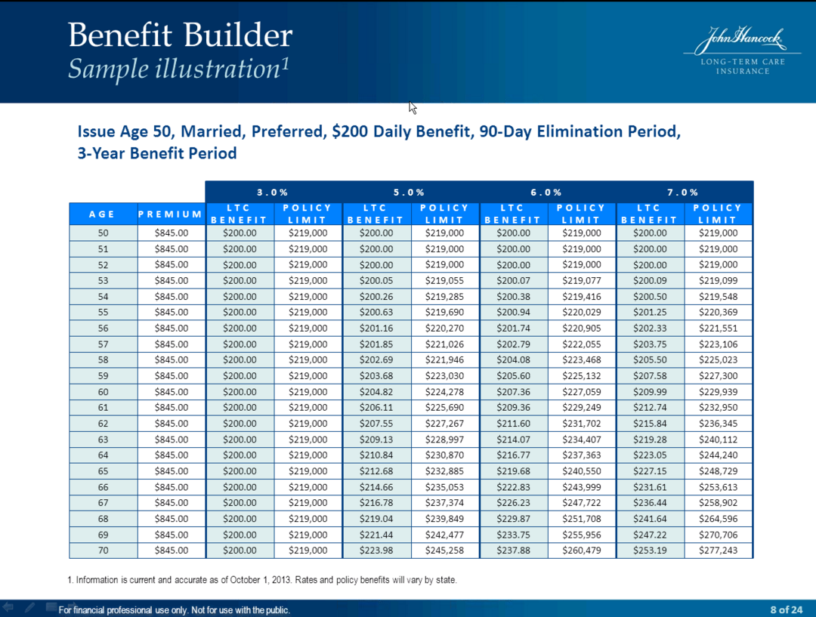
Notes:
Potential Growth Investment Return minus 3% Base = Paid Up Additional Coverage

Slide 7
Notes:
Very Affordable

Slide 11
Notes:
Wayne Reynolds- (Agent former Major League Baseball Player)- 60% of Policies for ages 60-52. Totally change from 5 years ago. Completely different mind set than older generation. Benefit Builder fits in by a more affordable price and more leverage. Most clients take savings with BB and put it back in the premium getting more coverage upfront. Baby boomers can save premiums now and buy more later using buy up option.
90% of clients take savings and add it to the premiums.

Slide 12
Case:
JH BB $250 per day 6 year Benefit has pool of 547,000 with at $217 per month
Competitor: with 3% Compound same pool 547,000 with a $396 per month
UP FRONT LOAD JH Policy
$450 a day with new pool of $985,000 at $396 per month!

Slide 13
Objections to BB not being guaranteed?
Assume BB has no gain going forward, still ahead of the game with up front loading the policy. Any increases is just icing on the cake.
Always use Optional Cash Benefit that does not reduce pool of money!
Captivate is almost live in all states.
November is LTC Awareness Month- Get the Ball Rolling!
How to start the conversation with your clients.
3 New Videos showing conversations with clients.

