Slide 1


Platinum Facts and Figures

Slide 2
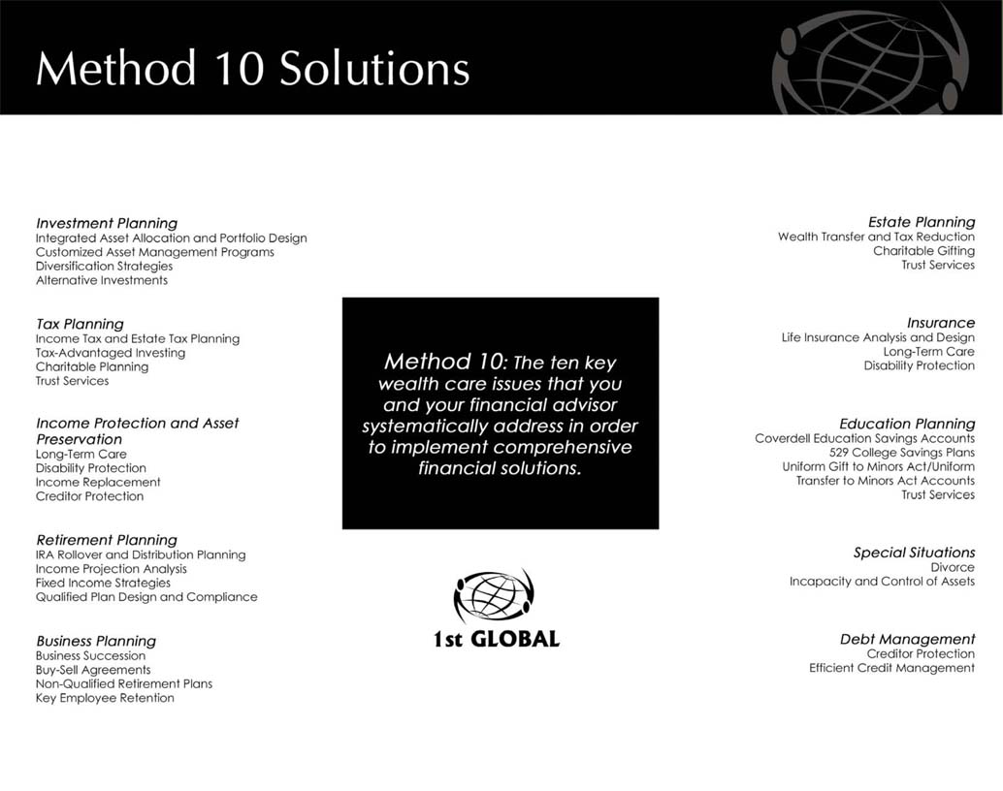

Slide 3
“The first step in the risk management process is to acknowledge the reality of risk. Denial is a common tactic that substitutes deliberate ignorance for thoughtful planning.”
--Charles Tremper

Slide 4
1. What percentage of Americans entering the work force today will become disabled before they retire?
  43%
  26%
  48%
  18%
2. What percentage of the American population classifies themselves as fully or partially disabled?
  6%
  43%
  12%
  100%

Slide 5
3. According to the Social Security Administration, how many disabled workers are there currently collecting disability benefits?
  12 million
  8 million
  2 million
  27 million
4. As of December 2010, what percentage of those employees collecting SSDI benefits were under the age of 50?
  12%
  30%
  66%
  50%

Slide 6
5. The average long-term disability lasts how long?
  2.5 years
  4 years
  5 years
  18 months
6. According to the commissioners disability insurance tables, what percentage of workers will be disabled for more than five years during their working careers?
  6%
  12%
  20%
  30%

Slide 7
7. Medical problems contributed to what percentage of bankruptcies in 2007?
  43%
  62%
  53%
  12%
8. What was the leading cause of disability claims in 2009?
  Neck, back and joints
  Mental nervous disorders
  Cardiovascular
  Cancer

Slide 8
9. What percentage of American families spend more than they earn?
  27%
  44%
  62%
  18%
10. What percentage of American families have NO savings earmarked for emergencies?
  60%
  40%
  30%
  80%

Slide 9
Chances Of Becoming Disabled
Just over one in four of today’s 20 year-olds will become disabled before they retire.
Over 36 million Americans are classified as disabled, about 12% of the total population. More than 50% of those disabled Americans are in their working years, from 18-64.

Slide 10
8.3 million disabled wage earners, over 5% of US workers, were receiving Social Security Disability (SSDI) benefits at the conclusion of March 2011.
In December 2010, there were over 2.5 million disabled workers in their 20s, 30s and 40s receiving SSDI benefits.
Source: www.disabilityacanhappen.org/chances_disability/disability_stats

Slide 11
How Long Could You Afford To Be Without A Paycheck?
Do you spend more than you earn? 44% of US families do.
Do you have private pension coverage? Most of us - over 50% - don’t.
Retirement savings? One-third of us have none.
60% of adult Americans have NO savings earmarked for emergencies.

Slide 12
71% of Americans would find it very difficult or some what difficult to meet their current financial obligations if their next paycheck was delayed for one week.
65% of working Americans say they could not cover normal working expenses even for a year if their employment income was lost; 38% could not pay their bills for more than three months.

Slide 13
Nearly nine in ten workers (86%) surveyed believe that people should plan in their 20s or 30s in case an income limiting disability should occur:
  Only half (50%) of all workers have actually planned for this possibility.
  Fewer than half (46%) have even discussed disability planning.
Source: www.disabilityacanhappen.org/chances_disability/disability_stats

